Slide 1

Quantum Machine Learning and Applications in Healthcare
Wade L. Schulz, MD, PhD - Yale School of Medicine
Code and Presentation: https://github.com/acomphealth/odsc-quantum/

Slide 2
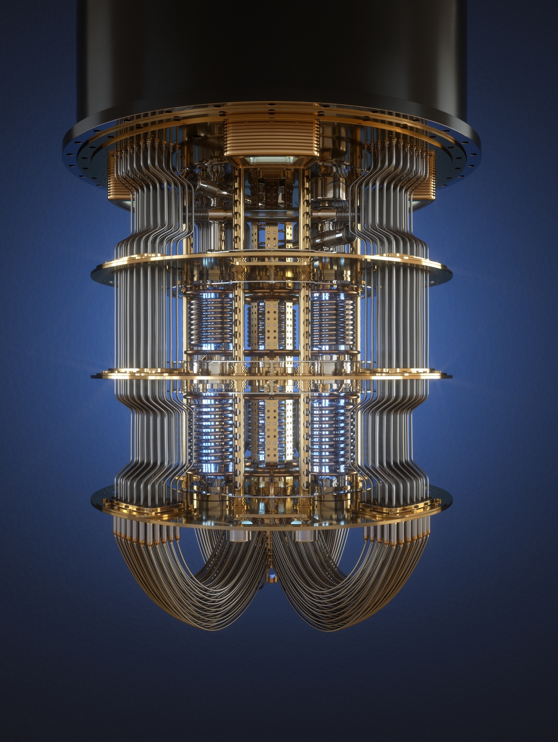
Quantum Machine Learning
sampler_qnn = SamplerQNN(
circuit=qc,
input_params=feature_map.parameters,
weight_params=ansatz.parameters,
interpret=parity,
output_shape=output_shape,
sampler=sampler
)
sampler_classifier = NeuralNetworkClassifier(
neural_network=sampler_qnn,
optimizer=optimizer
)
sampler_classifier.fit(train_features, train_labels)
y_pred = sampler_classifier.predict(test_features)

Slide 3
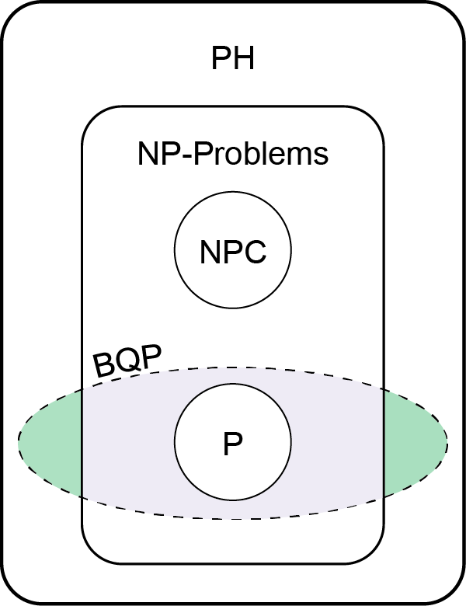
Promises of Quantum Compute
Exponential increases in power with each quantum bit that is added to a system
Excel at solving problems that are too large or complex for traditional compute
BQP (Bounded-error Quantum Polynomial time) is a complexity class that represents problems that can be efficiently solved by a quantum computer

Slide 4
Potential Applications in Biomedicine
Area of Application | Description
Drug Discovery | Molecular interaction simulation Drug behavior modeling Variational Quantum Eigensolver (VQE), Quantum Phase Estimation Algorithm (QPEA)
Protein Folding | Quantum Approximate Optimization Algorithm (QAOA)
Genomics | Transcript modeling Variant effect prediction / database searching Grover’s Search Algorithm
Medical Imaging | Quantum Principal Component Analysis (QPCA), Quantum Neural Network (QNN)
Healthcare Optimization | Scheduling / Resource Allocation Treatment Planning Quantum Approximate Optimization Algorithm (QAOA)
Machine Learning | Feature Selection Quantum ML Algorithms

Slide 5
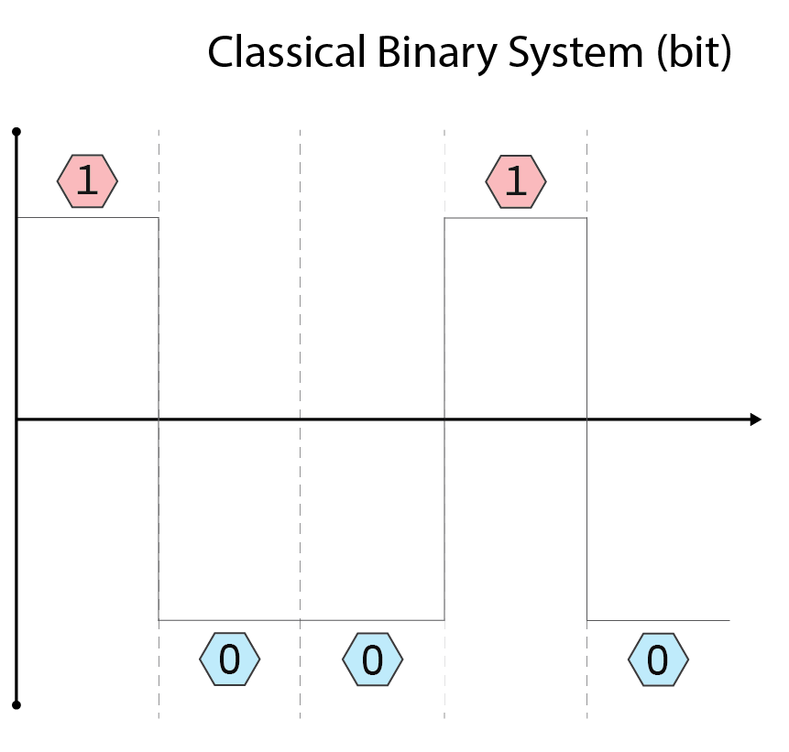
Classical Computing - Bits
Classical bits represent binary data as 0 or 1 by using voltage levels in a circuit
By flipping the voltage between two predefined levels, such as a high voltage to signify a 1 and a low voltage for a 0, the state of a bit can be easily switched, stored, and transmitted
The use of voltage levels in this manner allows for a straightforward, reliable method of encoding and processing digital information

Slide 6
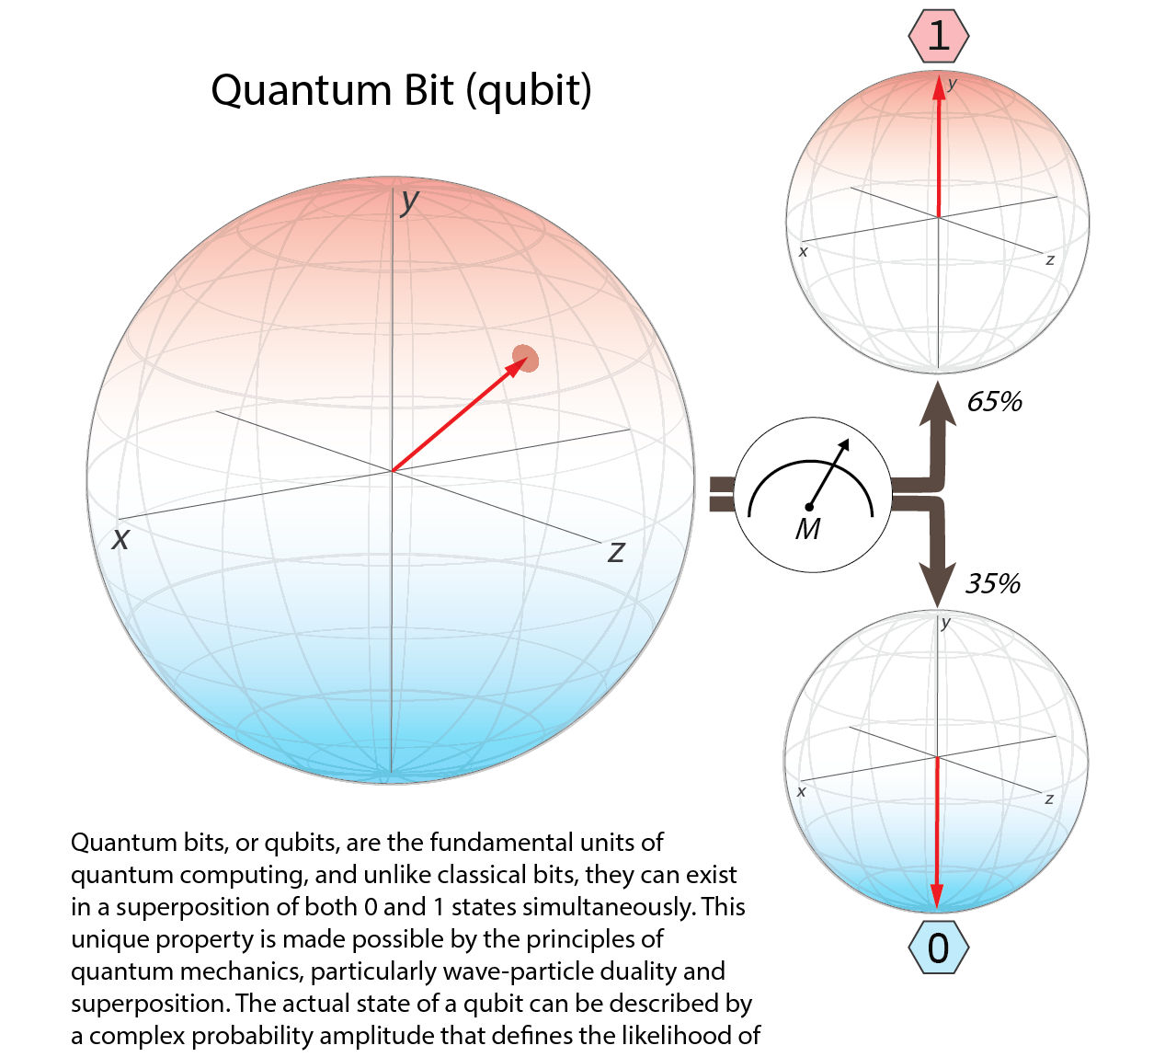
Quantum Computing - Qubits
Quantum bits, or qubits, are the fundamental units of quantum computing, and unlike classical bits, they can exist in a superposition of both 0 and 1 states simultaneously
This unique property is made possible by the principles of quantum mechanics, particularly wave-particle duality and superposition. The actual state of a qubit can be described by a complex probability amplitude that defines the likelihood of observing either a 0 or a 1 upon measurement
When a qubit is measured (M→), its superposition collapses to one of the two classical states (0 or 1)

Slide 7
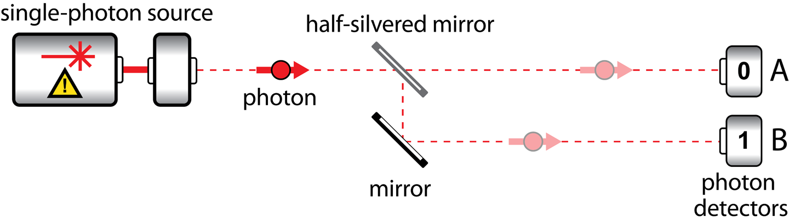
Qubits and Superposition
Programming Quantum Computers. Jonston ER, Harrigan N, Gimeno-Segovia M.

Slide 8
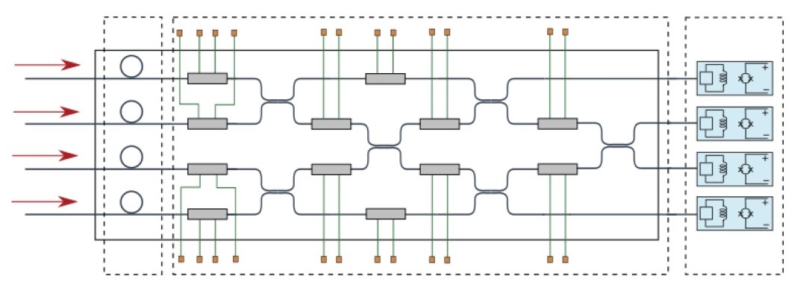
Qubits and Entanglement
https://galileo-unbound.blog/2021/12/20/twenty-years-at-light-speed-the-future-of-photonic-quantum-computing/

Slide 9
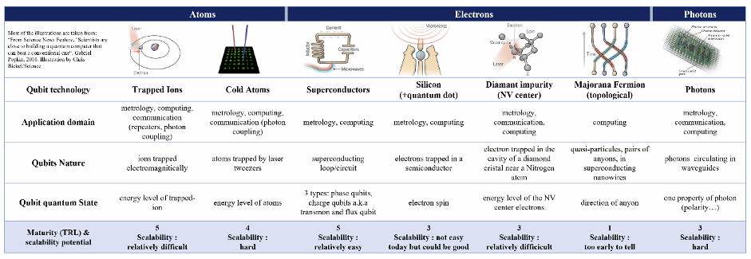
What is a Qubit Made Out Of?
Michel Kurek, Feb 2021

Slide 10
Quantum Computing Architectures
Gate-Based Quantum Computing
Quantum Annealing
Adiabatic Quantum Computing
Quantum Simulation
Topological Quantum Computing
Measurement-Based Quantum Computing

Slide 11
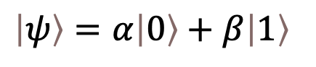
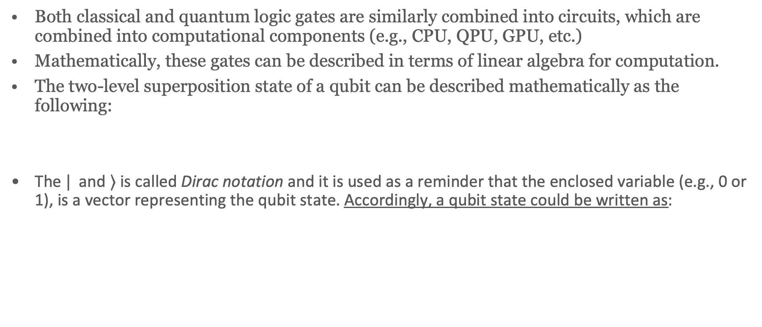
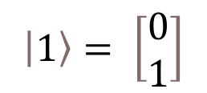
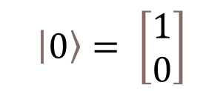
Classical and Quantum Circuits
Both classical and quantum logic gates are similarly combined into circuits, which are combined into computational components (e.g., CPU, QPU, GPU, etc.)
Mathematically, these gates can be described in terms of linear algebra for computation.
The two-level superposition state of a qubit can be described mathematically as the following:
The $|$ and $⟩$is called Dirac notation and it is used as a reminder that the enclosed variable (e.g., 0 or 1), is a vector representing the qubit state. Accordingly, a qubit state could be written as:
$$\left|ψ\right\rangle =α\left|0\right\rangle +β\left|1\right\rangle$$
$$\left|0\right\rangle = \left[\begin{matrix}1 \\ 0\end{matrix}\right]$$
$$\left|1\right\rangle = \left[\begin{matrix}0 \\ 1\end{matrix}\right]$$
and

Slide 12
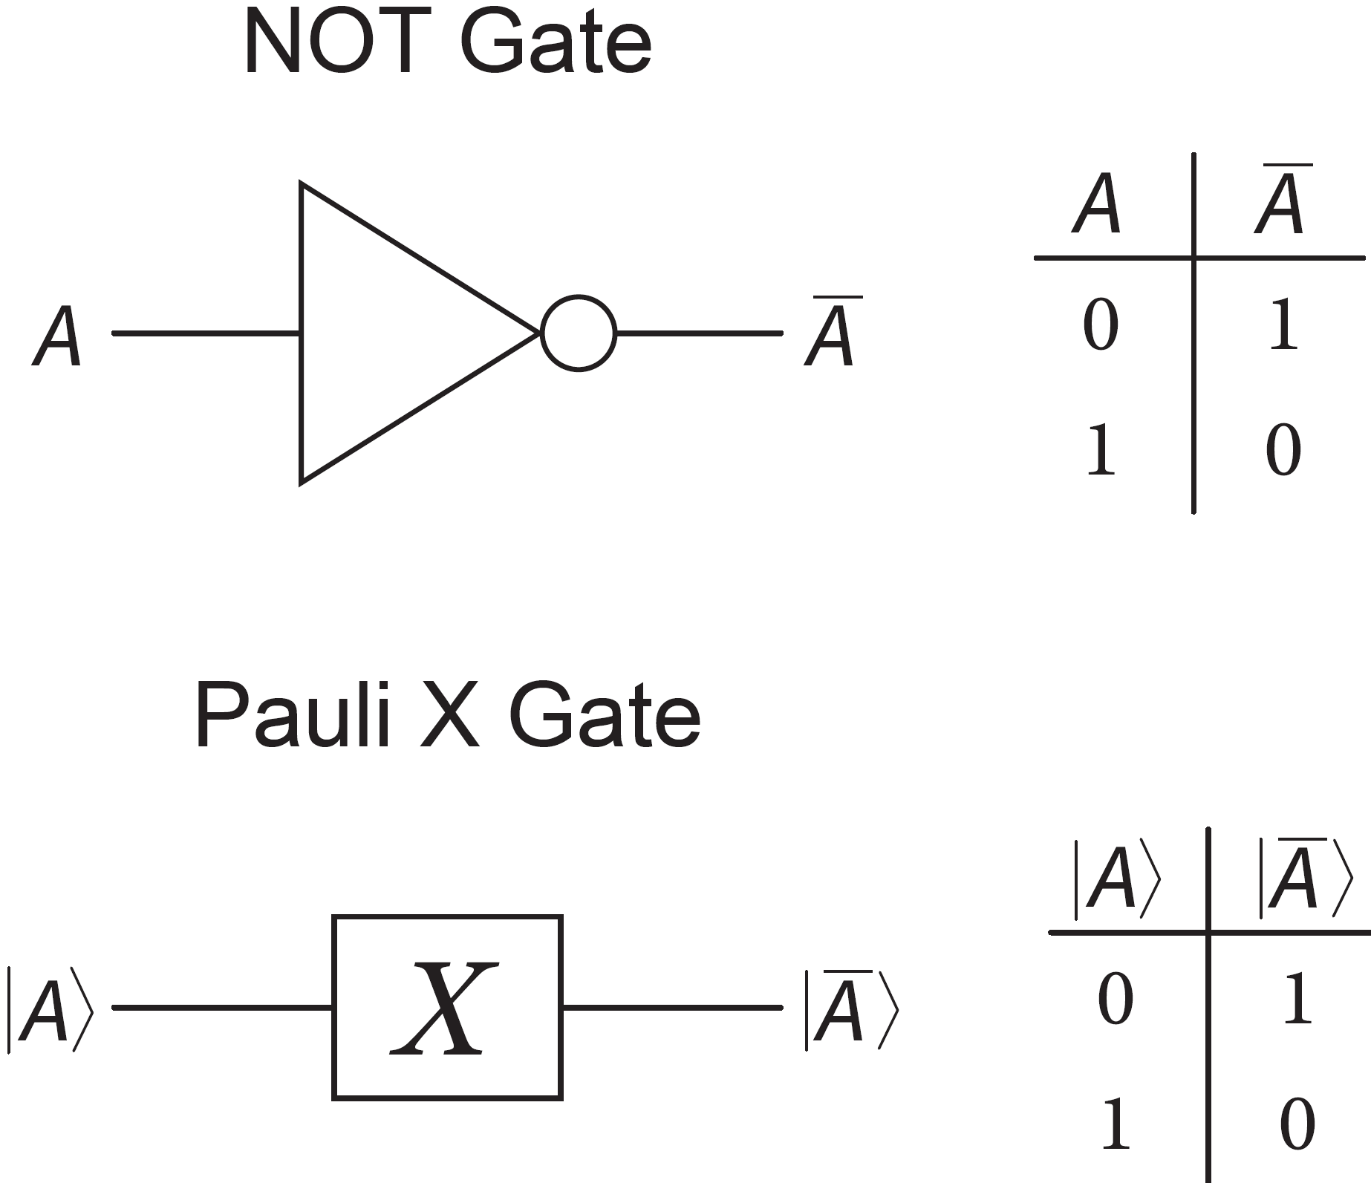
Logic Gates
Logic gates form the basis of digital circuits and make decisions based on one or more inputs
Classical computers interact operate on traditional bits through logical operations called gates such as AND, XOR, and NOT
Computations for quantum states are facilitated by linear operators referred to as quantum logic gate, which can be represented via linear algebra

Slide 13
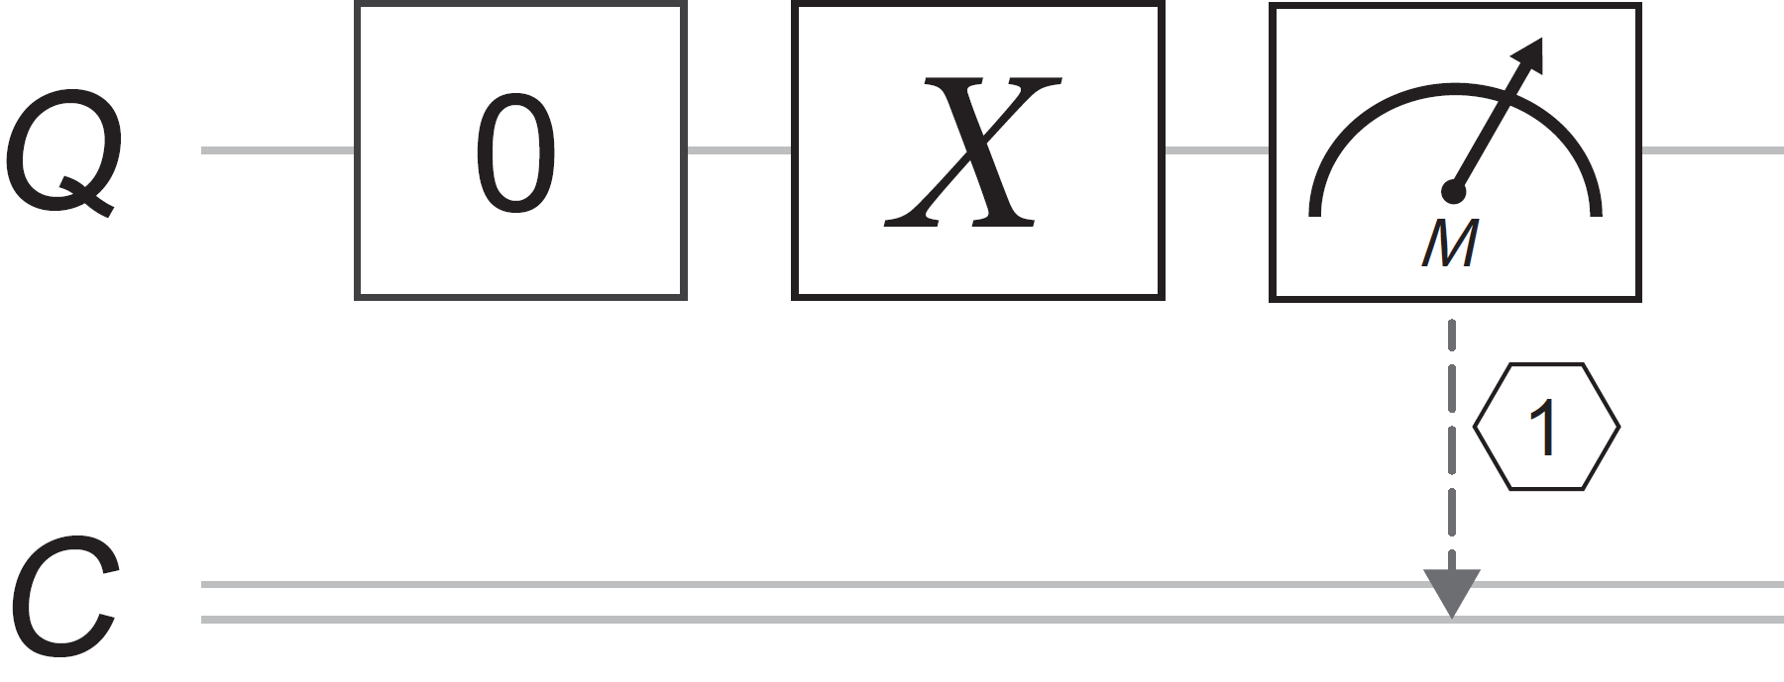
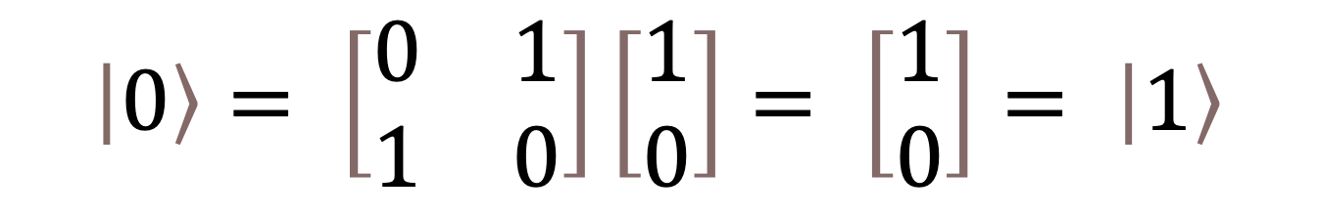
Quantum Logic Gates
$$\left|0\right\rangle = \left[\begin{matrix}0 & 1 \\ 1 & 0\end{matrix}\right]\left[\begin{matrix}1 \\ 0\end{matrix}\right]= \left[\begin{matrix}1 \\ 0\end{matrix}\right]= \left|1\right\rangle$$
Recommended Reading: Programming Quantum Computers. Jonston ER, Harrigan N, Gimeno-Segovia M.

Slide 14




Frameworks for Quantum Development
Qiskit (primarily IBM Cloud)
Microsoft QDK / Q#
Cirq (primarily Google)
TensorFlow Quantum

Slide 15
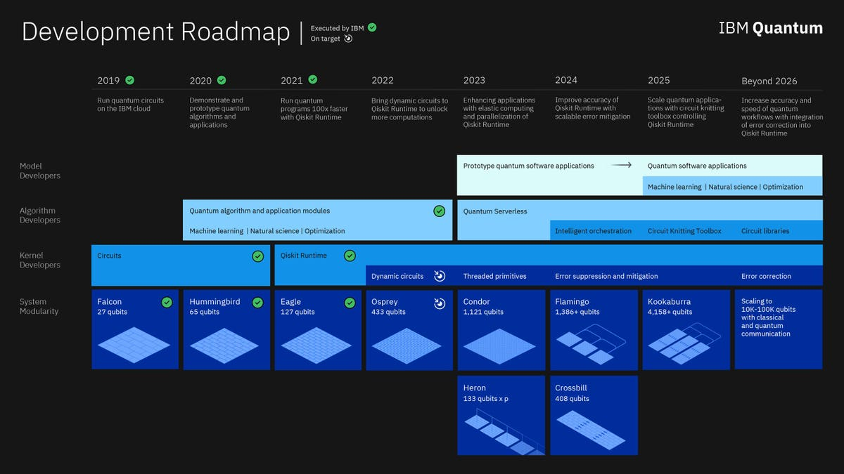
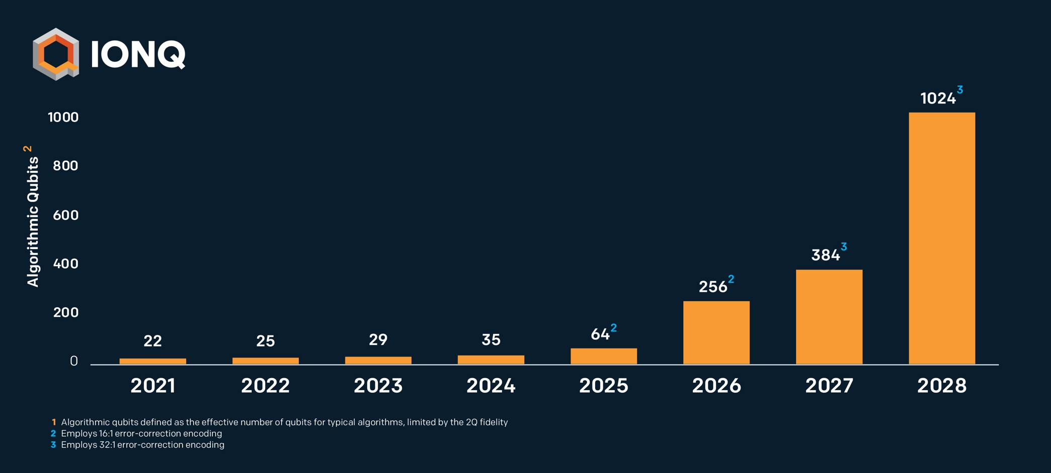
Advances in Quantum Compute Capacity

Slide 16
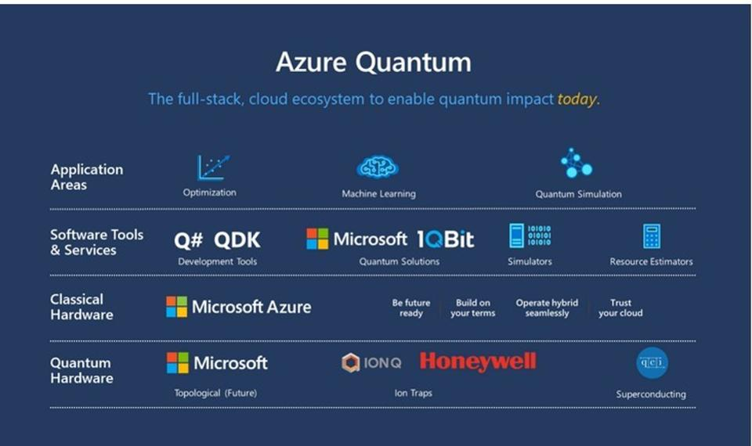
Simulators and Quantum Hardware
https://moorinsightsstrategy.com/research-notes/quantum-computing-trifecta-previewed-on-microsoft-azure-quantum-at-build-2020/

Slide 17
Quantum Development Example – Environment Setup
Code examples: https://github.com/acomphealth/odsc-quantum
Local conda environment
conda create –n qiskit python=3.10
conda activate qiskit
pip install –r requirements.txt

Slide 18
Quantum Development Example

Slide 19

Quantum Machine Learning
Quantum computing may enhance various aspects of machine learning including feature selection, optimization, data clustering, and classification. By leveraging the quantum properties of superposition and entanglement, quantum machine learning algorithms can explore larger solution spaces and potentially find more optimal solutions compared to classical counterparts.

Slide 20



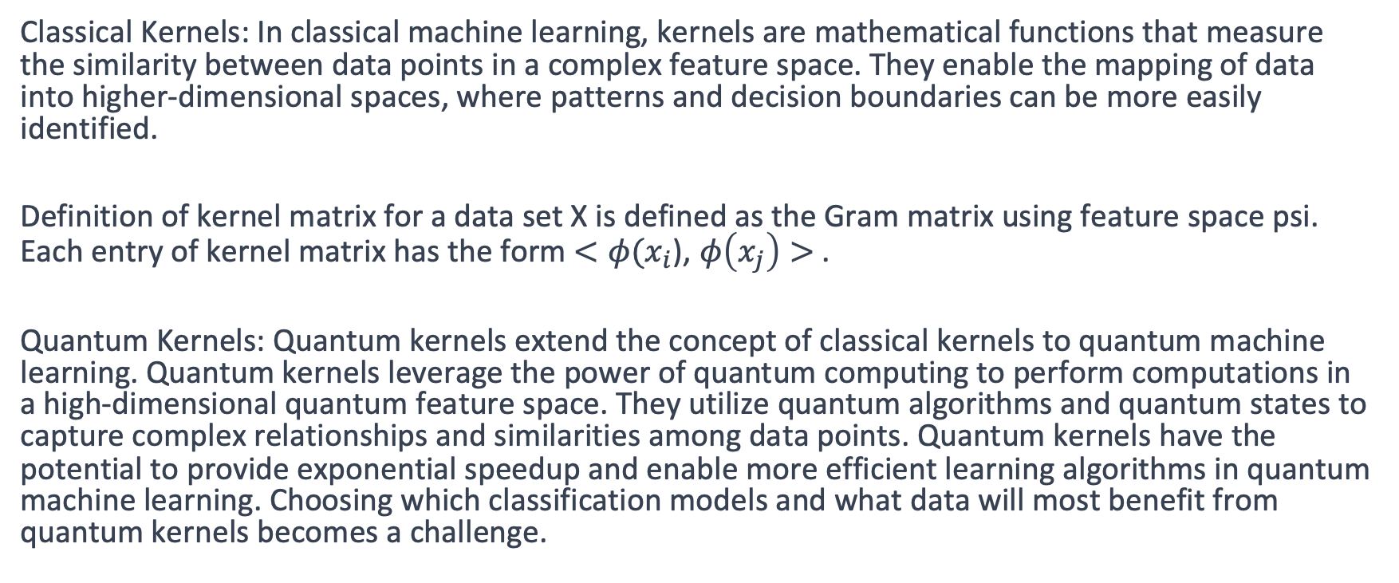
Quantum Machine Learning
Classical Kernels: In classical machine learning, kernels are mathematical functions that measure the similarity between data points in a complex feature space. They enable the mapping of data into higher-dimensional spaces, where patterns and decision boundaries can be more easily identified.
Definition of kernel matrix for a data set X is defined as the Gram matrix using feature space psi. Each entry of kernel matrix has the form $<φ(x_{i}$), $φ\left(x_{j}\right)>$.
Quantum Kernels: Quantum kernels extend the concept of classical kernels to quantum machine learning. Quantum kernels leverage the power of quantum computing to perform computations in a high-dimensional quantum feature space. They utilize quantum algorithms and quantum states to capture complex relationships and similarities among data points. Quantum kernels have the potential to provide exponential speedup and enable more efficient learning algorithms in quantum machine learning. Choosing which classification models and what data will most benefit from quantum kernels becomes a challenge.

Slide 21


Quantum ML: A Healthcare Example
Dataset: The project utilizes the Wilkes dataset, which consists of 2,084 PAA (Polyacrylamide Gel Electrophoresis) profiles. The dataset contains 24 continuous variables and 4 categorical variables. It focuses on proteomics data and includes both normal and abnormal labels.
Wilkes E.H., Emmett E., Beltran L., Woodward G.M., Carling R.S. A machine learning approach for the automated interpretation of plasma amino acid profiles. Clin. Chem. 2020 Sep 1;66(9):1210–1218.

Slide 22
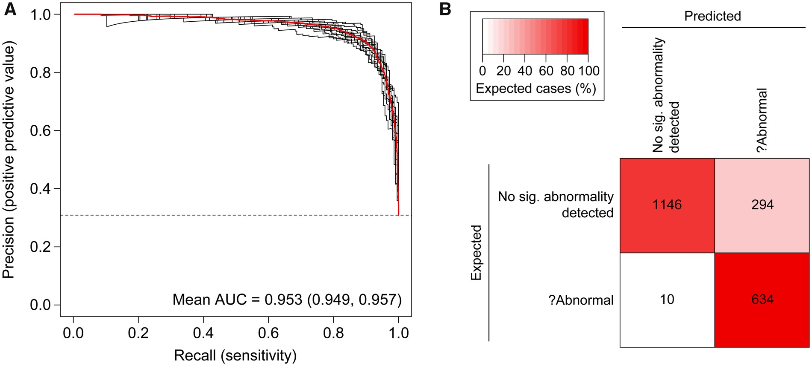
Performance with Traditional ML Approaches
Wilkes E.H., Emmett E., Beltran L., Woodward G.M., Carling R.S. A machine learning approach for the automated interpretation of plasma amino acid profiles. Clin. Chem. 2020 Sep 1;66(9):1210–1218.

Slide 23
Quantum ML Approach – Algorithm Selection
PegasosQSVC: PegasosQSVC is a quantum machine learning algorithm available in Qiskit. It combines the principles of classical Pegasos (Primal Estimated sub-GrAdient Solver for SVM) with a quantum kernel to perform support vector classification on quantum data.
Variational Quantum Circuits (VQC): Variational quantum circuits, also known as parameterized quantum circuits, are fundamental building blocks for hybrid quantum-classical algorithms. These circuits consist of two phases: the quantum phase and the classical phase.
Quantum Phase: In the quantum phase, the circuit prepares the quantum state by parameterizing the input data (X) using a set of free parameters (θ) and performs quantum operations using a quantum circuit. The heart of the variational circuit lies in this quantum phase.
Classical Phase: The classical phase involves the measurement of an observable measurements at the output of the quantum circuit. The measurement results, together with the objective function and learning algorithm, form the classical phase of the VQC algorithm.
Quantum Neural Network (QNN): Universal fault-tolerant quantum computers have been theoretically proven capable of solving certain problems faster than any classical computer. Demonstrated numerically that a class of quantum neural networks is able to achieve a considerably better effective dimension than comparable feedforward networks and train faster, suggesting an advantage for quantum machine learning.
https://doi.org/10.1038/s43588-021-00084-1

Slide 24
Quantum ML Approach - Outline
Data Pre-Processing
Dimensionality Reduction
Quantum Feature Map
Quantum Sampler
Quantum Optimizer
Quantum Circuit
Train / Test

Slide 25
Quantum ML – Limitations

Slide 26
Quantum ML Approach – Dimensionality Reduction
Principal Component Analysis (PCA) is a widely used dimensionality reduction technique
PCA transforms high-dimensional data into a lower-dimensional space while preserving the most relevant information and capturing patterns in the data.
PCA works by finding the principal components, which are orthogonal directions in the data space that explain the maximum amount of variance in the data.

Slide 27
Feature Map
Feature Map: In quantum machine learning, a feature map is responsible for encoding classical data into quantum states that can be processed by quantum circuits. It plays a similar role to neural networks in classical computing, capturing essential features and patterns from input data.
ZZFeatureMap: ZZFeatureMap is an out of the box feature map in Qiskit. It maps classical data into quantum states by utilizing quantum gates – one can customize the class PauliFeatureMap. The ZZFeatureMap is characterized by the number of repetitions, which determine the depth of the quantum circuit and the complexity of the mapping. We use 3 repetitions and linear entaglement for the PegasusQSVC ML algorithm.

Slide 28
TwoLocal / Ansatz
TwoLocal Ansatz: TwoLocal is an ansatz object provided by Qiskit that represents a parameterized quantum circuit. Ansatz circuits are a crucial component of variational algorithms in quantum machine learning. TwoLocal allows for the customization of variational circuit architecture by specifying layers and gates.

Slide 29
Optimizer
COBYLA Optimizer: The COBYLA optimizer is a constrained optimization algorithm used to optimize the parameters of the variational circuit. It is particularly suitable for optimization problems with inequality constraints. COBYLA approximates the objective function and constraints using linear approximations and iteratively refines the solution.

Slide 30
Quantum ML Approach – QNN Code Example

Slide 31
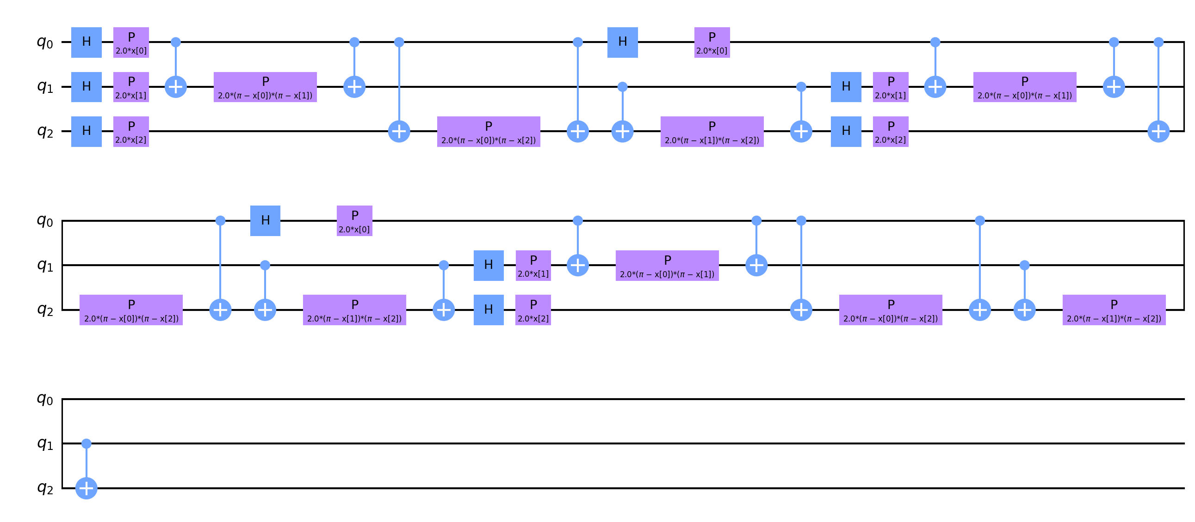
QNN Circuit – Feature Map

Slide 32
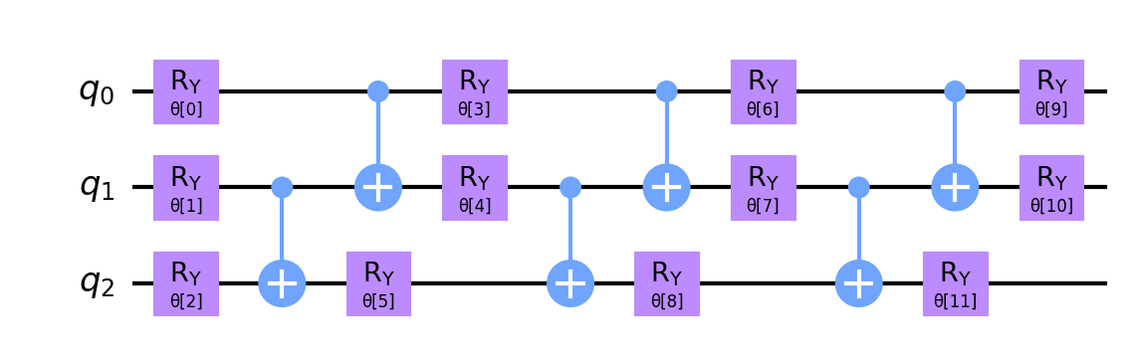
QNN Circuit – Ansatz

Slide 33
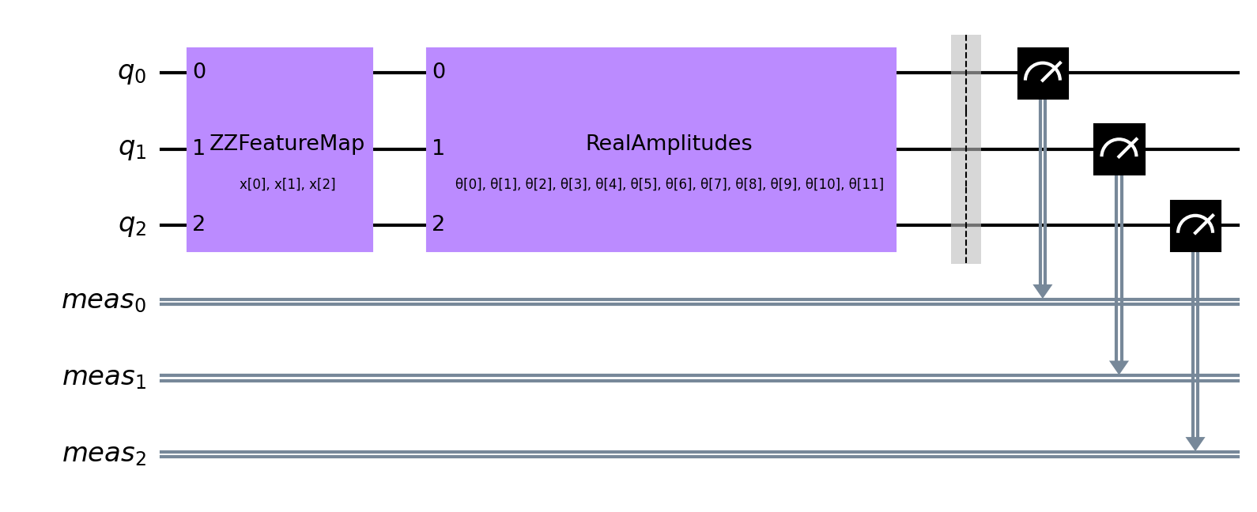
QNN Circuit – Complete

Slide 34
Quantum State Measurement

Slide 35
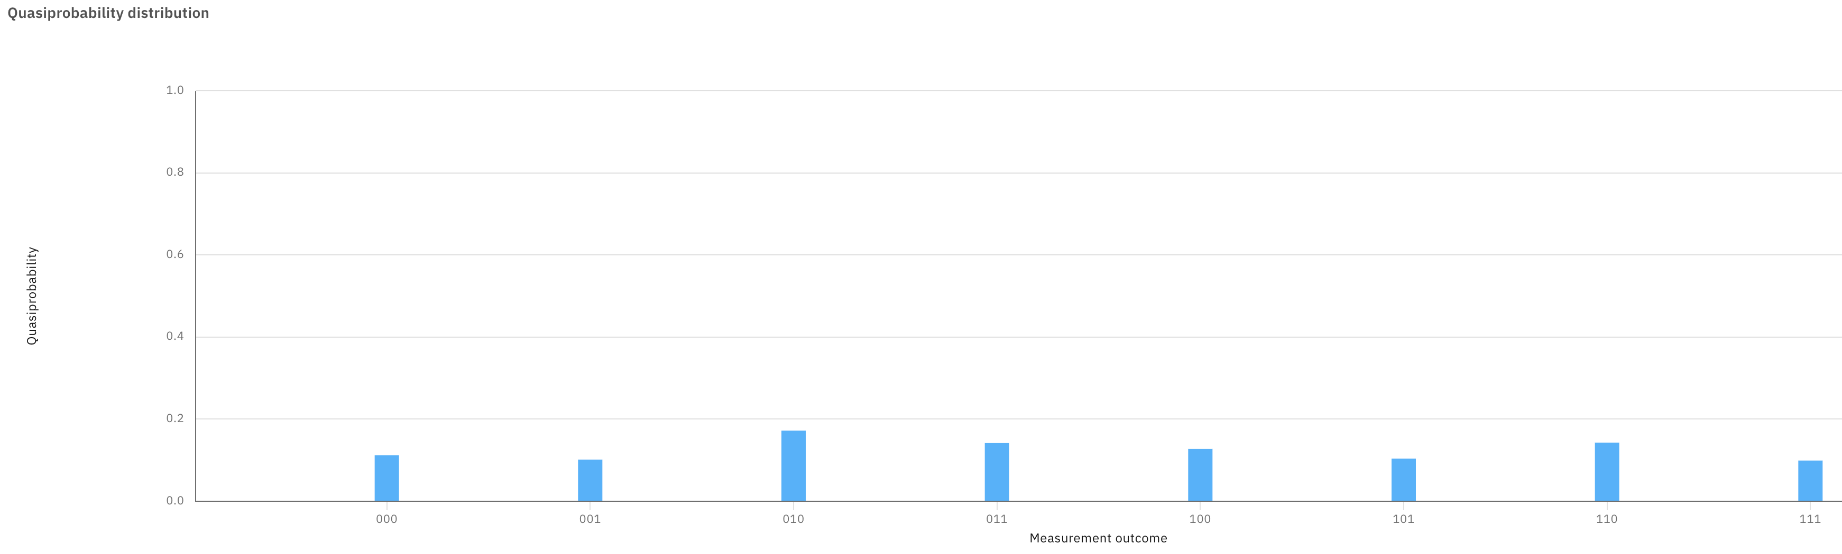
QNN Class Label - Hamming Function
Sum value of bits and divide by 2, class label is remainder
000 = (0 + 0 + 0) % 2 = 0
001 = (0 + 0 + 1) % 2 = 1
011 = (0 + 1 + 1) % 2 = 0
Then sum the probabilities for each class label, >= 50% (or threshold) is positive class

Slide 36
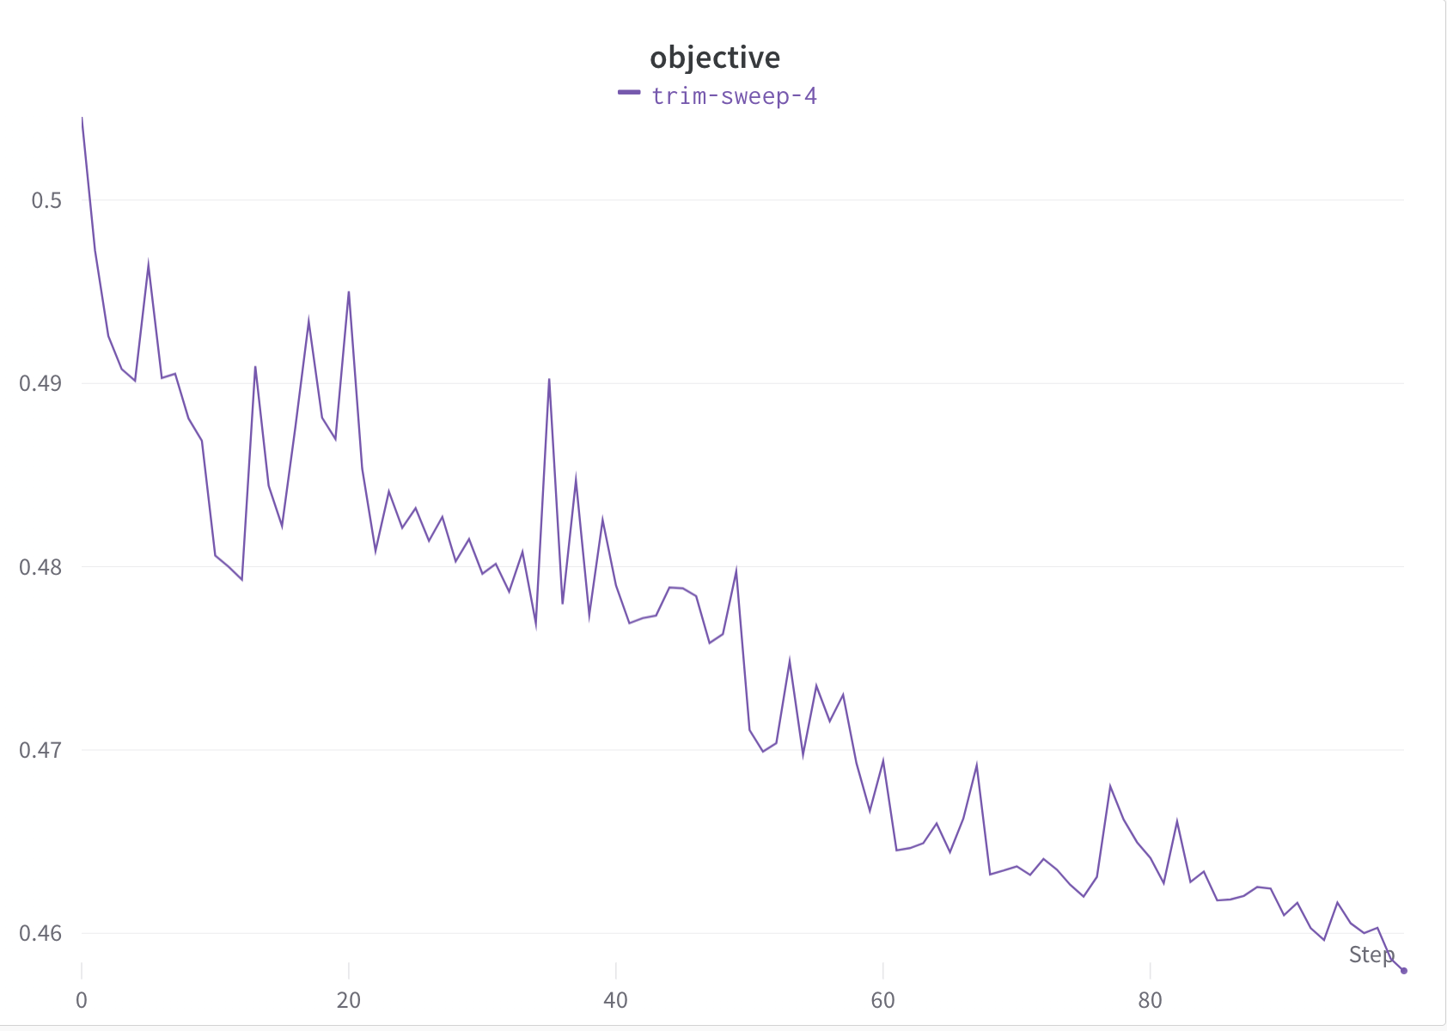
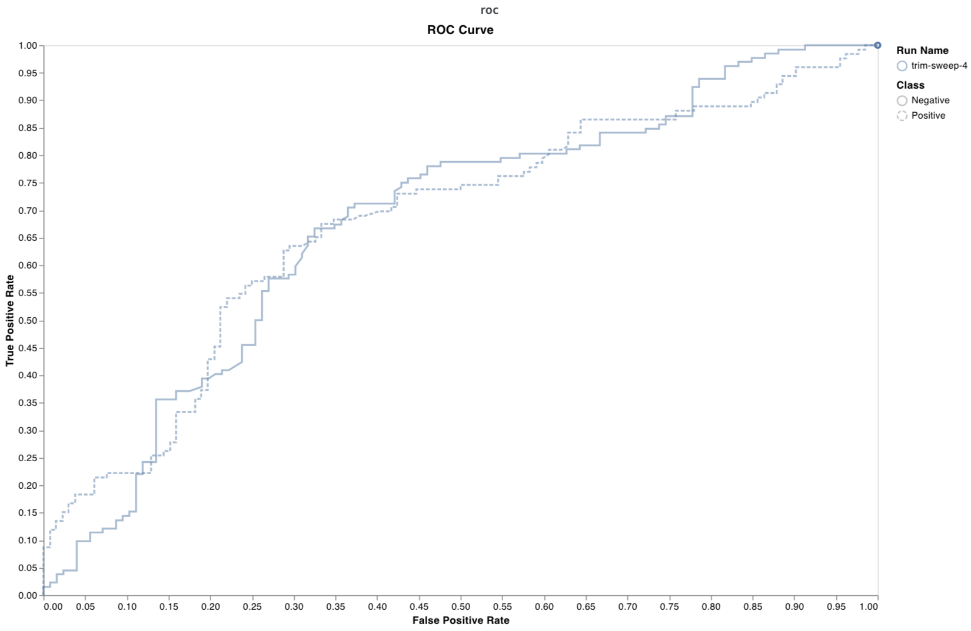
Quantum Neural Network Performance - Objective

Slide 37
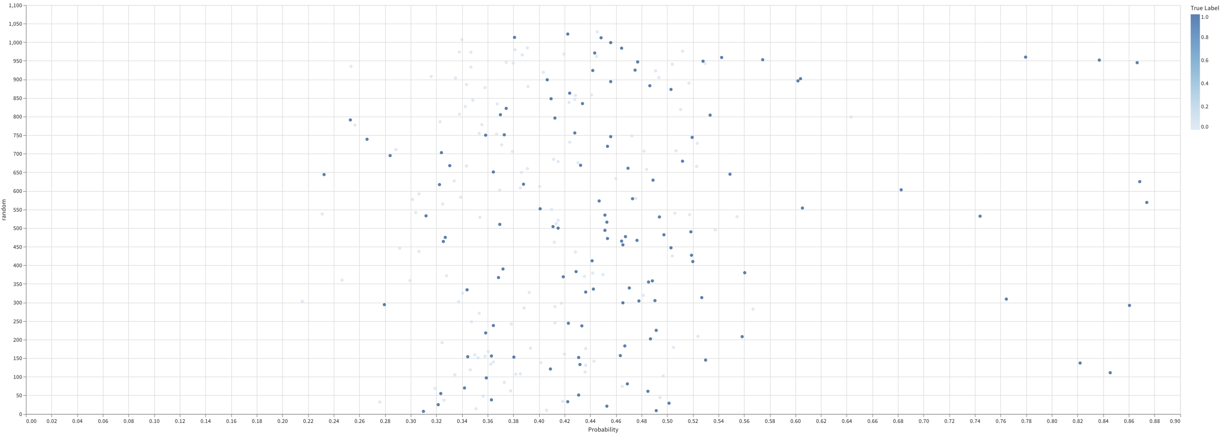
Quantum Neural Network Performance – Distribution Plot

Slide 38
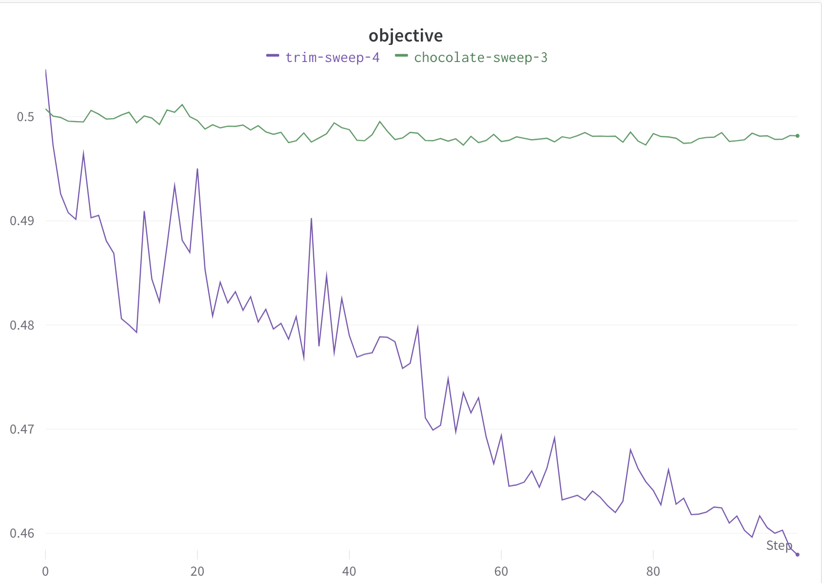
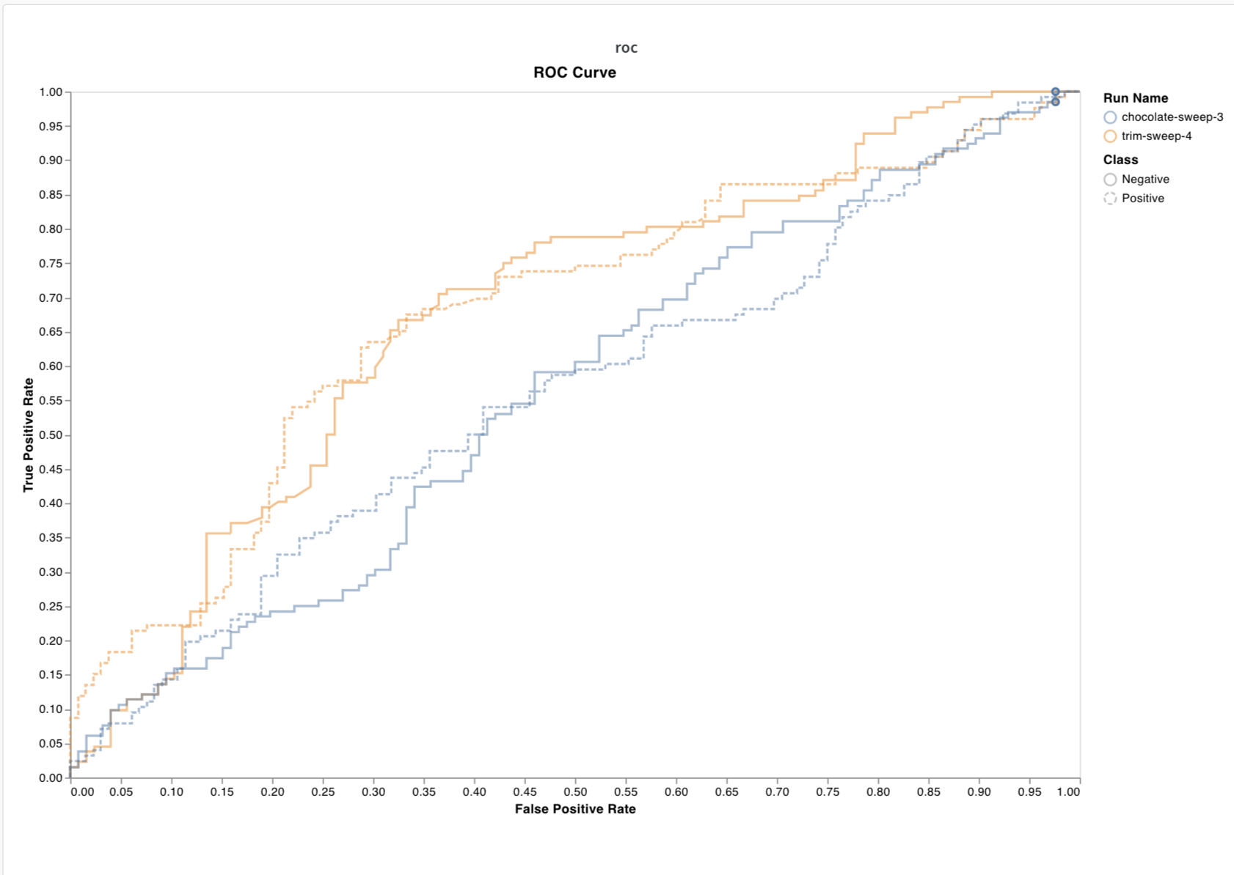
Quantum Neural Network Performance – Noisy Simulator
Simulators support addition of noise, but by default are non-noisy
In Qiskit, can select a system to model for noise based on actual hardware performance

Slide 39
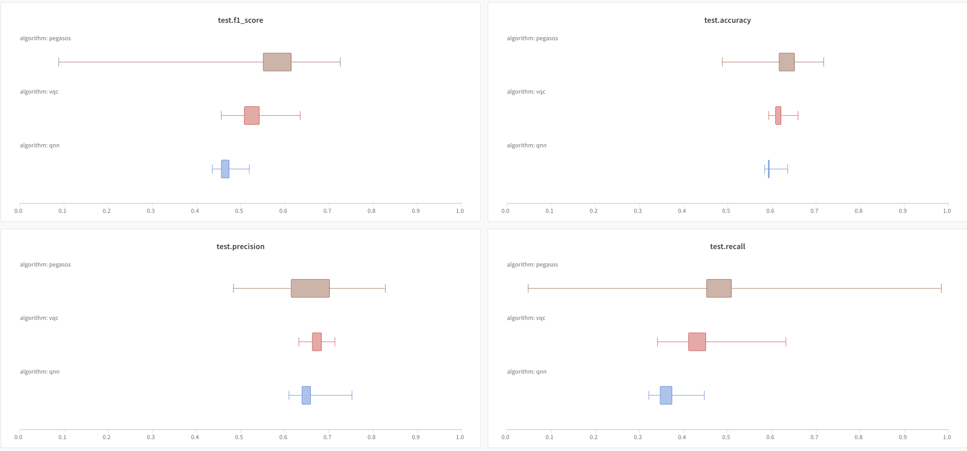
Quantum Performance by Algorithm

Slide 40
Performance Discussion / Conclusions
The QNN shows better than random performance at predicting abnormal results
Does not reach the performance levels of XGBoost on either raw data or dimensionally-reduced data (tested at 3, 5, and 7 components)
PegasosQVC performs the best for the three quantum algorithms tested
Adding noise to the simulator dramatically degrades predictive performance
Based on other research, these results are consistent, but evidence suggests that access to larger and error-corrected hardware in the future may see significant improvements in performance (both speed and predictive accuracy)

Slide 41
Next Steps
Refine algorithm / circuit design and assess simulated performance on complete feature set (rather than dimensionally reduced)
Assess performance on quantum hardware
Perform larger scale performance tuning / hyperparameter optimization on simulator and quantum hardware
Test performance of algorithms on other available data sets that may not perform as well when using traditional ML models

Slide 42

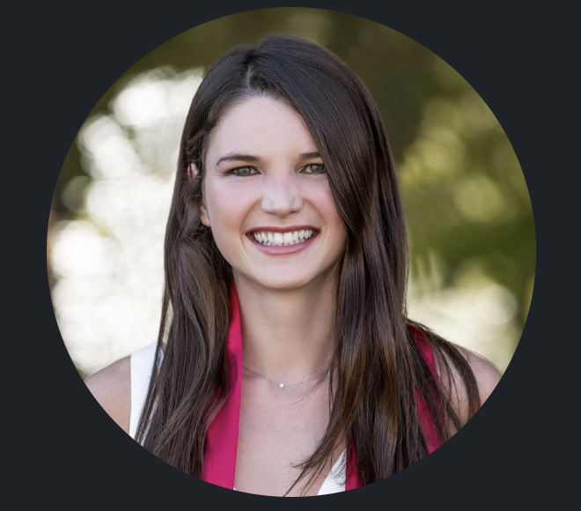



Acknowledgements
Thomas Durant, MD
Elizabeth Knight
Sarah Dudgeon
Brent Nelson, MD
Jacob McPadden, MD

Slide 43
Questions?
Wade L. Schulz, MD, PhD - Yale School of Medicine

